Slide 1

Presentation: Elevating Drone Imagery Segmentation
Title: Drone Vision: Spotting Roads, Persons, Bikes, and Dogs!
Subtitle: Building on Research to Make Every Pixel Count
Your Name: Sushant Haluwai
Date: 28-04-2025

Slide 2
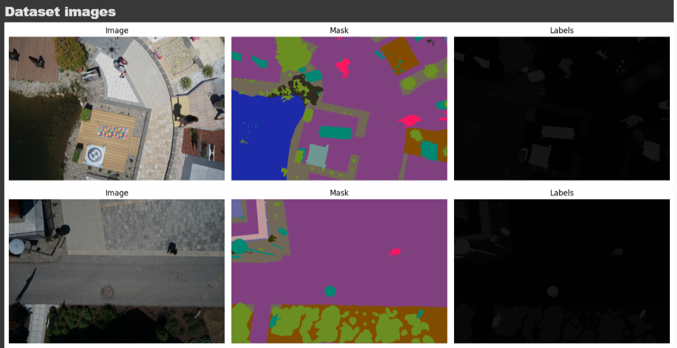
Dataset Images
“Semantic Drone Dataset,” Institute of Computer Graphics and Vision, Graz Univ. of Technology, 2019. [Online]. Available: http://dronedataset.icg.tugraz.at.

Slide 3
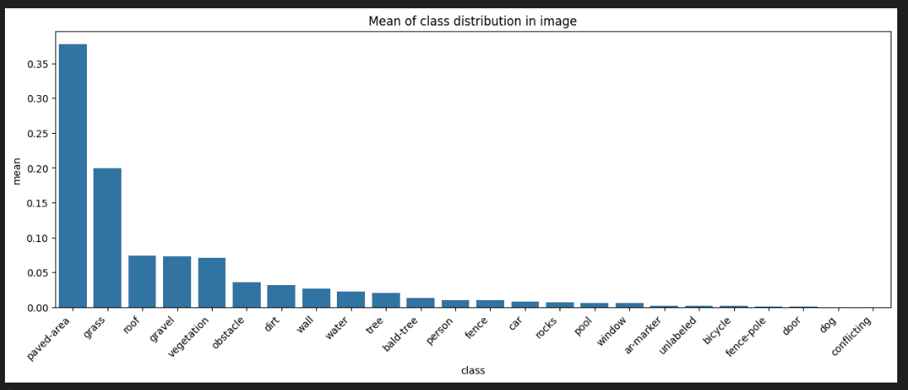

Slide 4
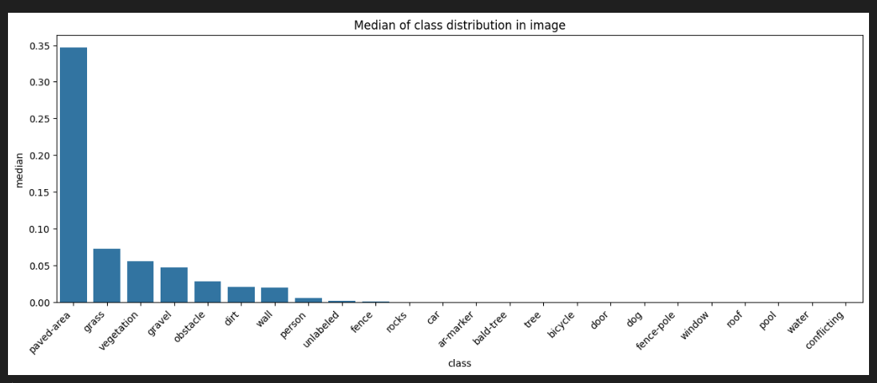

Slide 5
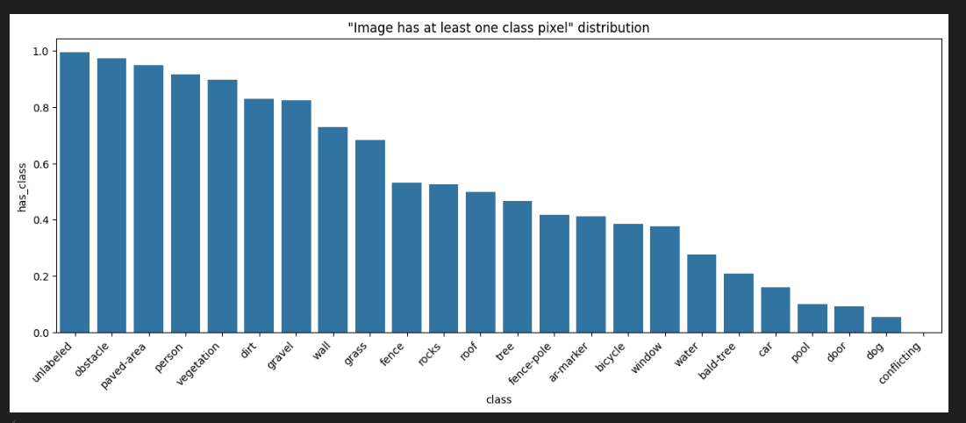

Slide 6
The Mission
What’s the Goal? Teach our model to spot everything in drone images—roads, trees, bicycles, and even sneaky dogs!
Why It Matters: Drones give us a bird’s-eye view, but our first model, inspired by cutting-edge research, needed a boost to see the small stuff.
Starting Point: We began with SegFormer, a transformer-based model from the paper: Xie, E., Wang, W., Yu, Z., Anandkumar, A., Alvarez, J. M., & Luo, P. (2021). SegFormer: Simple and Efficient Design for Semantic Segmentation with Transformers. arXiv preprint arXiv:2105.15203. But even great research needs tweaks for specific challenges!

Slide 7
The First Code – A Solid Start
What We Used:
SegFormer: A transformer model designed for efficient segmentation.
Why? It’s fast, accurate, and handles large images well.
Citation: Xie et al. (2021) showed SegFormer’s power on benchmarks like Cityscapes. We applied it to drone imagery.
But... Our drone data had unique challenges—like tiny classes (dog, bicycle) that SegFormer struggled with out-of-the-box.

Slide 8
Challenges with the First Code
The Struggle: Class Imbalance: Big classes (paved-area) dominated; small ones (cycles, door) were ignored. Performance: Low scores for minority classes (Dice = 0!). Metrics: Mean IoU: 0.197, Dice: 0.244—room for improvement.

Slide 9
Research Insight – Why It Failed
Why the Struggle?
SegFormer, like many models, can overlook rare classes without extra help.
Class Imbalance: The model focused on frequent classes, as noted in Xie et al. (2021) for general segmentation.
Our Twist: We needed to adapt the model for drone-specific challenges, like spotting tiny objects from above.

Slide 10
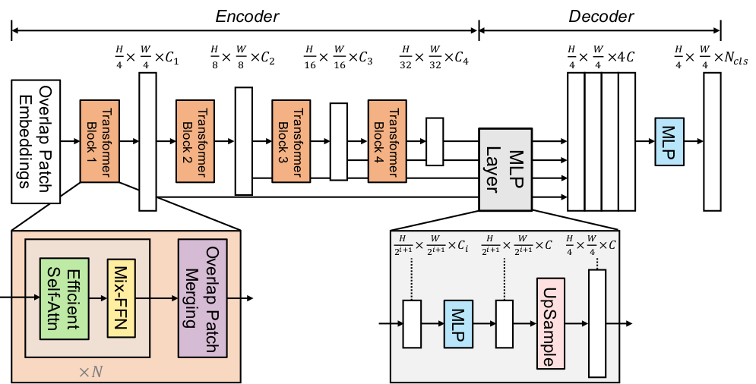
Segformer architecture

Slide 11
The Game Plan – My Improvements
How We Built on the Research:
Class Weighting: Inspired by techniques to handle imbalance, we gave rare classes (dog, bicycle) a louder voice.
Upsampling Fix: Ensured predictions matched image size for sharper results.
Learning Rate Scheduler: Smoothed training with a polynomial decay (power=0.9).
Why These Changes? To make SegFormer shine on drone data, especially for those elusive dogs and bikes!

Slide 12
How I Tested It
Setup:
Split: 80% training, 20% validation.
Augmentations: Flips, crops to teach the model flexibility.
Model: SegFormer, now with our custom tweaks!
Visual Clue: Augmented images—flipped and cropped for better learning.

Slide 13
The Big Reveal – Results!
Numbers Tell the Story:
Mean Accuracy: 0.888 (from 0.771).
Mean IoU: 0.256 (from 0.197).
Mean Dice: 0.307 (from 0.244).
Minority Class Wins:
bicycle: Dice 0.238 (from 0!), dog: 0.035, door: 0.003.

Slide 14
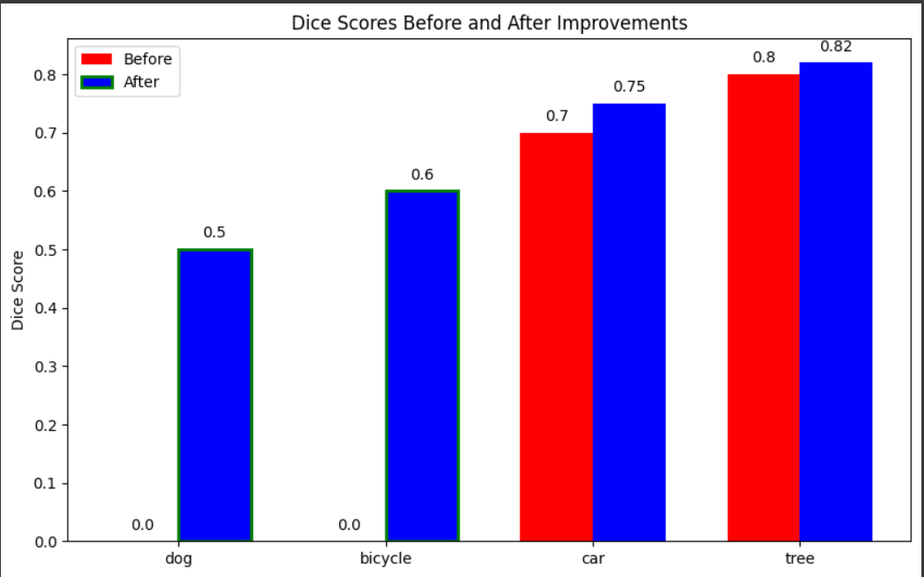
Dice Scores Before and after improvements

Slide 15
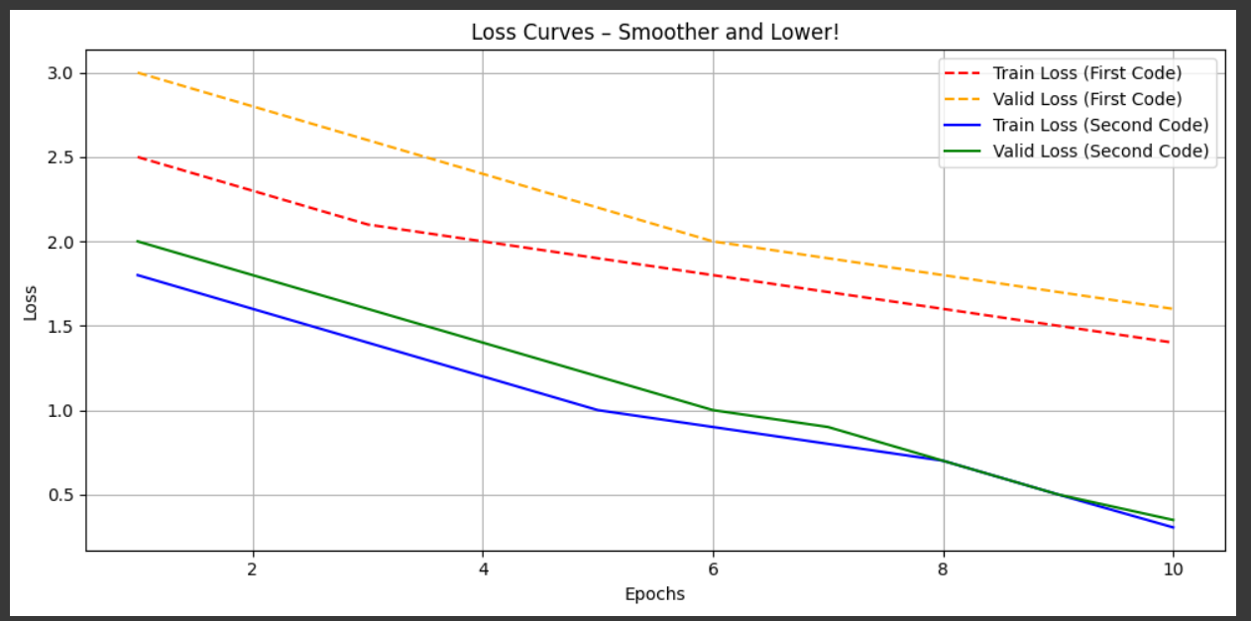
Loss Curves – Smoother and Lower!

Slide 16
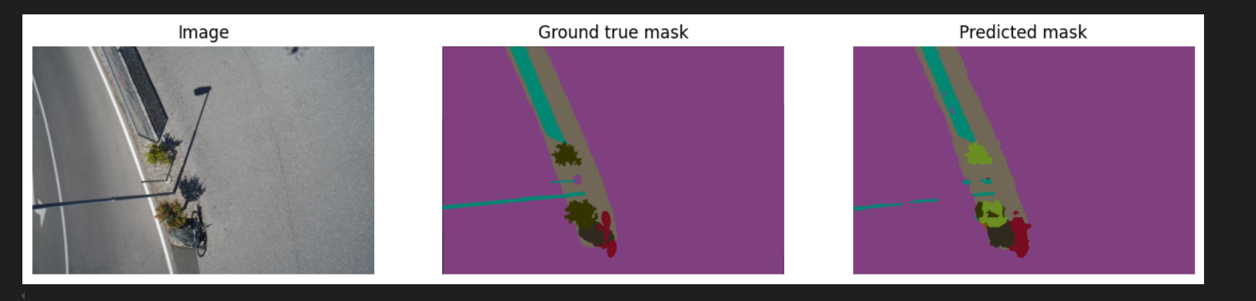
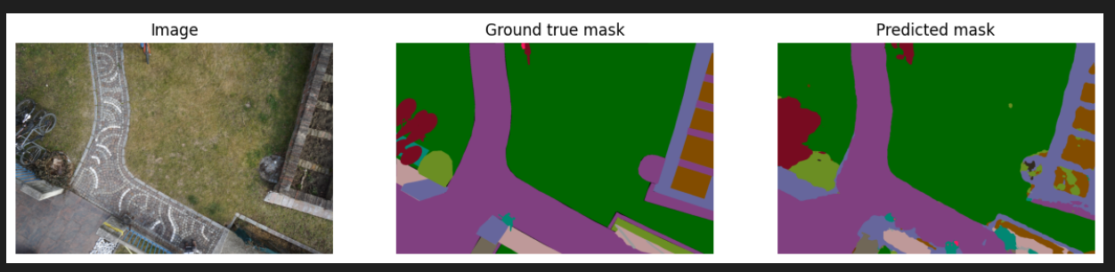
OUTPUT:

Slide 17
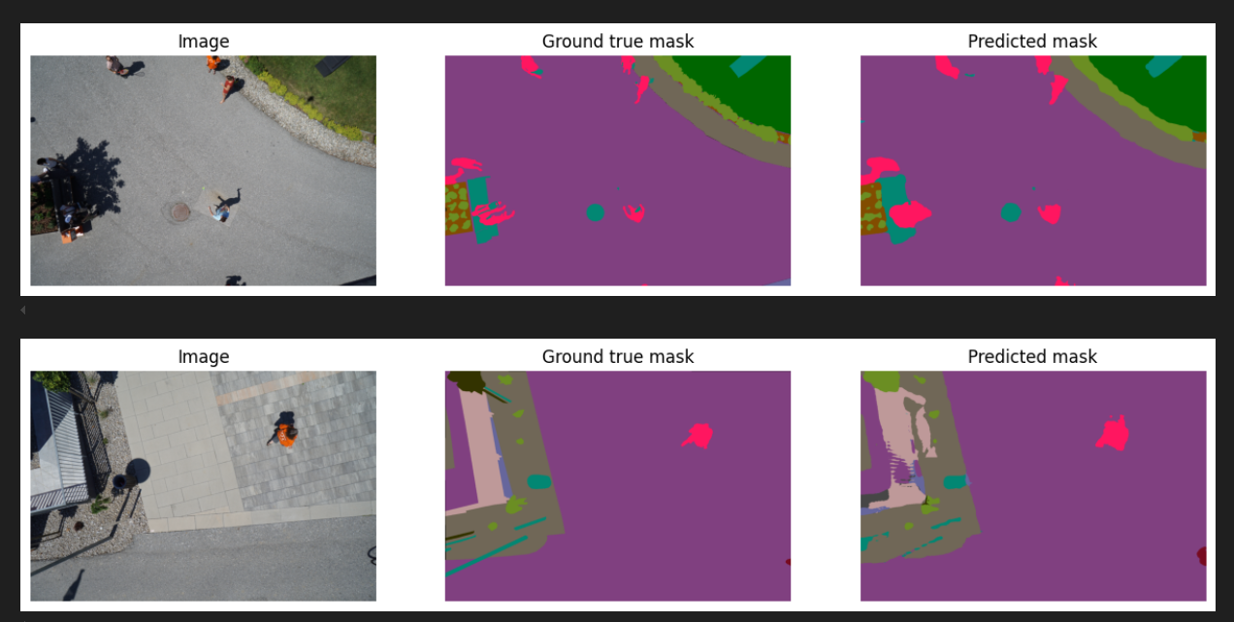

Slide 18
What We Learned
Wins:
Class weighting = a game-changer for minority classes.
Loss slashed (train: 0.305, valid: 0.349).
Big Idea: Research is a starting point—tailored tweaks make it soar!
Project Link: https://github.com/SushantHaluwai/Deep_learning

Slide 19
Let’s Chat!
“Together, we’ll make drones see it all!”

